Slide 1
Javascript & DOM

Slide 2
Javascript – main properties
is a lightweight scripting language (language used to control the browser) that is run on the client-side (browser)
developed by Netscape and Sun Microsystems and introduced first in the Netscape Navigator 2.0
is intended to add interactivity and dynamic functionality to HTML pages
is interpreted, not compiled, inserted directly in HTML pages
is an object-oriented language that inherits many features from Java, but it is not Java
is understood by most browsers
is an event-based language, weakly typed
current version is ECMAScript 2016 (2016)

Slide 3
What can Javascript do ?
it can detect the type of browser
it can react to various events of the browser
it can alter the structure of the html document (modify, delete, add tags on the run-time)
it can validate data before being sent to the server
it can not modify local (client) files

Slide 4
Base elements of Javascript
Js inherits from Java simple data types, operators, instruction syntax
Js has predefined objects: DOM-related and general objects: Array, Boolean, Date, Error, EvalError, Function, Math, Number, Object, Range Error, ReferenceError, RegExp, String, SyntaxError, TypeError, URIError
Js has some global functions (not related to objects): decodeURI, decodeURIComponent, encodeURI, encodeURIComponent, eval, isFinite, isNaN, parseFloat, parseInt
comments: // or /*…*/
Js is weakly-typed: a variable can be bound to a specific type, then to a different type, during the course of a program execution

Slide 5
Types and literals (constant values)
numbers: integer (in base 2, 8, 10, 16) and real
boolean: true and false
null
undefined: a variable that does not have an assigned value;
NaN: not a number
String: ‘text’, “something” etc.; methods of the string class can be applied on any string literal (e.g. “sir”.length)
vectors: [‘a’, , , ‘bbb’, ‘ccc’] will have 5 elements
objects: lists of zero or more pairs “property : value”
ex.: dog = {name: dog, type: animal, characteristics: getProps(“dog”), age: 4}

Slide 6
Variables
loosly-typed language:
  a variable can be bound to different types during its lifetime;
  the value of a variable is automatically converted to other types when necessary
  the type of a variable needs not be declared
a variable is declared with “var” or just by assigning a value to it:
var name;
root=“some text”;
i = root+1; // i=“some text1”
a variable without a value assigned to it will be evaluated to “undefined” or NaN (depending on the context) if it was declared with “var” or will give a run-time error if it was not declared with “var”

Slide 7
Operators
3 types of expressions in Js: arithmetic (eval. to a number), string and boolean (eval. to true or false)
assign operators: =, +=, -=, *=, /=, %=, <<=, >>=, >>>=, &=, ^=, |=
comparison operators: ==, !=, >, >=, <, <=
arithmetic operators: %, /, ++, --, +, -
bitwise operators: &, |, ^, ~, >>, <<, >>>
logic operators: &&, ||, !
string operator: + (concatenation)
special operators

Slide 8
Special operators
identity operators: === (eguality and of the same type), !== (not equal and/or of different types)
ternary operator: condition ? true-expr : false-expr
comma: expr1, expr2, …, exprN
new: creates a new object
this: refers to the calling object in a method
typeof: typeof(“test”) => string
delete: deletes an object or a property from an object or an element from a vector
in: propNameorNumber in objectName
instanceof: objectName instanceof objectType
void: evaluates an expression without returning a value

Slide 9
Instructions (borrowed from Java)
conditional: if, switch
loop: for, do while, while, label, break, continue
for (variable in object) { … statements …} : cycles through thee properties of an object
with (object) { … statements … } : sets the default object for a set of statements
exception handling instructions:
try { … statements … } catch (exception) { … }
throw expression;

Slide 10
Functions
usually they are declared in the <head> tag and called all over the html file
the syntax of declaring a function is:
function name_fct(parameters, arguments) {
… statements …
}
where parameters represent specific parameters sent to the function, arguments contain a variable number of arguments; the variable arguments can be accessed inside the function through arguments[i],where i goes from 0 to arguments.length
all arguments are passed to the function through value; only object properties changes are visible outside the function

Slide 11
Classes and objects
Js is a prototype-based language, it does not distinct between a class and a class instance (object); it only has objects; current object referred with “this”
An object is an associative array augmented with a prototype
creating objects can be done in 2 ways:
  using an object initializer:
  objectName = {property1:value1, property2:value2,..., propertyN:valueN}
  using a constructor function:
  function print() {…}
  function thing(x, y, z) { prop1=x; prop2=y; prop3=z; method1=print;}
  ob = new thing(a, b, c);
objects are deleted using “delete objectName”
properties are accessed using obj.property or obj[index_property]
new properties can be added to object on run-time: obj.newProp=val

Slide 12
Predefined objects
Array – working with arrays (sort, push etc.)
Boolean – true or false
Function – specifies a string of code to be precompiled as a function
Date – date functions
Math – math functions
Number – numerical constants and representations
RegExp – regular expressions
String – string operations

Slide 13
Events
Javascript is an event-based language
Event: mouse click, key pressed, element loosing focus etc.
when an event is triggered by the browser a predefined or user-defined (in Javascript) event handler takes control
event handlers are associated to a tag:
1) <TAG eventHandler=“Javascript code”>
2) <script type=“text/javascript”>
function evHandle(x) { … }
</script>
<TAG eventHandler=“evHandle(this)”>
3) <script type="text/javascript">
obj.eventHandler=“Javascript code”;
</script>

Slide 14
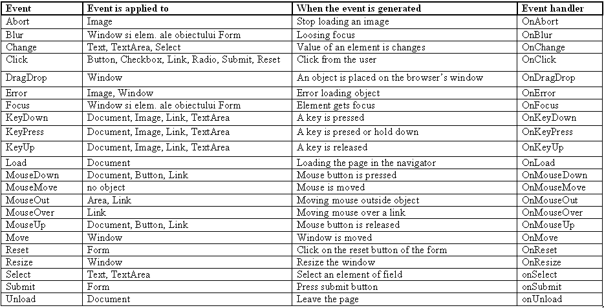
Events (2)

Slide 15
Javascript and HTML
Js scripts can be used in HTML documents in 4 ways:
1) as instructions or functions written inside a <SCRIPT> tag:
<script type=”text/javascript”>
… JavaScript statements...
</script>
2) Js code written in a separate javascript file:
<script src="common.js"></script>
3) using a Js expression as the value of an html attribute:
<hr width="&{barWidth};%" align=“left">
<h4>&{myTitle};</h4>
JavaScript entities start with “&” and end with “;” and are enclosed in “{}”
4) as an event handler:
<input type="button" value="Press Me" onClick="func()">

Slide 16
Pop-up boxes
alert(“…text…”) : displays text and the Ok button
confirm(“… text…”) : displays text and returns true if the Ok button is clicked and false if the Cancel button is clicked
prompt(“text”, “default value”): the user can enter an input value and then click Ok (return the value) or Cancel (return null)

Slide 17
DOM (Document Object Model)
is a standardized (by W3C) hierarchical model of an HTML or XML document
DOM can be used for navigating in the document structure, modify the document structure (add, delete, modify child elements etc.) and also modifying attributes of an element
each tag is a DOM object
it has an API which can be used in Javascript
Javascript + DOM is sometimes called DHTML (Dynamic HTML)

Slide 18
DOM Browser Objects
Window object
Navigator object
Screen object
History object
Location object

Slide 19
DOM document objects
Document object
Anchor object
Area object
Base object
Body object
Button object
Event object
Form object
Frame object
Frameset object
IFrame object
Image object
Input Button object
Input Checkbox object
Input File object
Input Hidden object
Input Password object
Input Radio object
Input Reset object
Input Submit object
Input Text object
Link object
Meta object
Object object
Option object
Select object
Style object
Table object
TableCell object
TableRow object
Textarea object

Slide 20
Document object collections
Collection | Description
forms[] | Returns a reference to all Form objects in the document
images[] | Returns a reference to all Image objects in the document
links[] | Returns a reference to all Area and Link objects in the document
anchors[] | Returns a reference to all Anchor objects in the document

Slide 21
Document object properties
Property | Description
body | Gives direct access to the <body> element
cookie | Sets or returns all cookies associated with the current document
domain | Returns the domain name for the current document
lastModified | Returns the date and time a document was last modified
referrer | Returns the URL of the document that loaded the current document
title | Returns the title of the current document
URL | Returns the URL of the current document

Slide 22
Document object methods
Method | Description
close() | Closes an output stream opened with the document.open() method, and displays the collected data
getElementById() | Returns a reference to the first object with the specified id
getElementsByName() | Returns a collection of objects with the specified name
getElementsByTagName() | Returns a collection of objects with the specified tagname
open() | Opens a stream to collect the output from any document.write() or document.writeln() methods
write() | Writes HTML expressions or JavaScript code to a document
writeln() | Identical to the write() method, with the addition of writing a new line character after each expression

Slide 23
Additional Documentation
http://www.cs.ubbcluj.ro/~forest/wp
http://www.w3schools.com/js/default.asp
http://www.w3schools.com/jsref/dom_obj_document.asp
http://devedge-temp.mozilla.org/central/javascript/index_en.html
https://developer.mozilla.org/en/JavaScript

